Slide 1
CSCI 488 Project Design | Keydials
Team Members: Jean Eckelberg & Alex Tjellesen

Slide 2
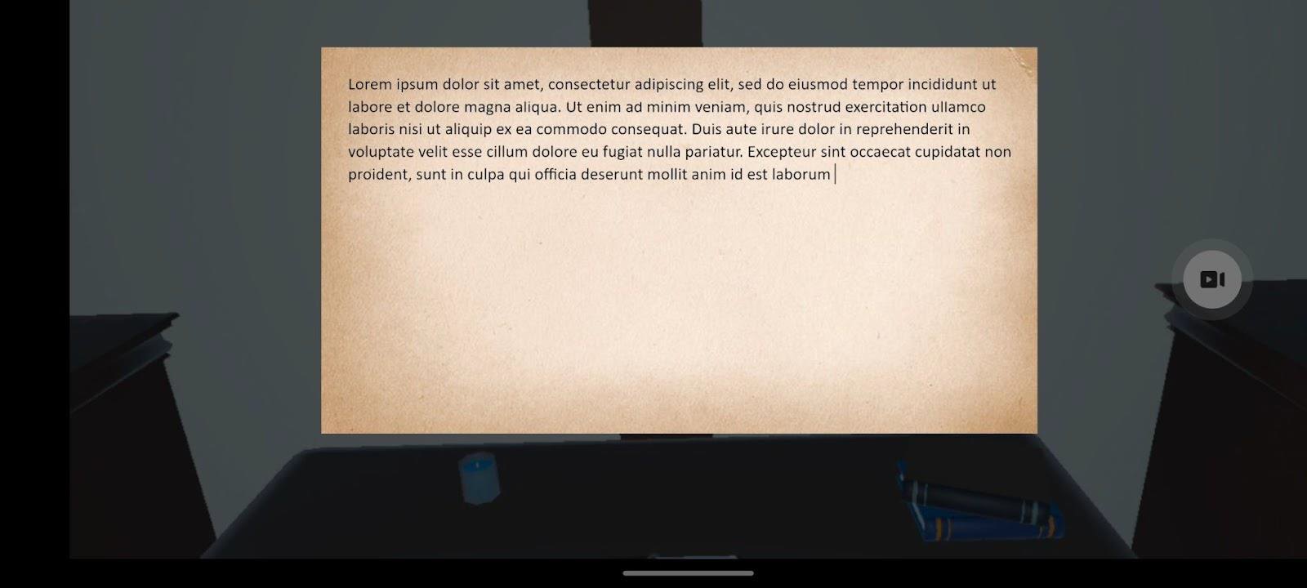


Keydial and Text Input Prototype

Slide 3

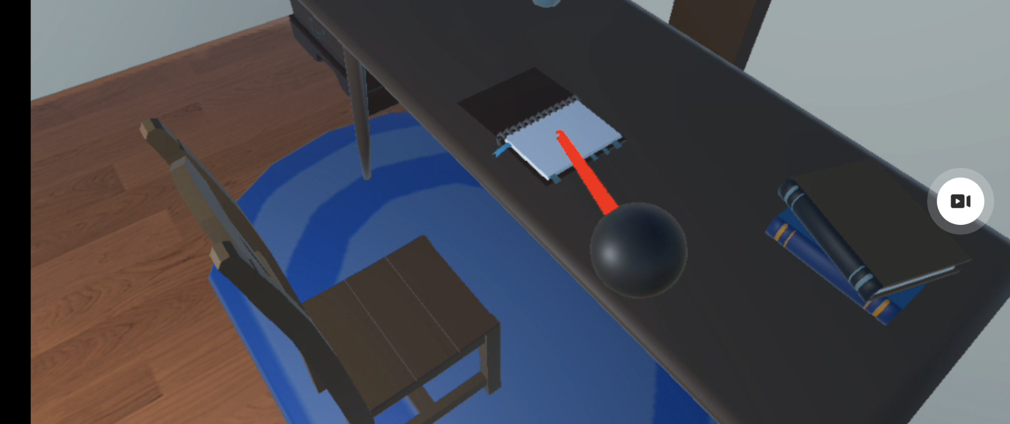

Environment Prototype

Slide 4
Eight Golden Rules:
#5 - Prevent Errors
The top key of each dial is blank to prevent misinput after accidental selection of an undesired wheel.

Slide 5
Eight Golden Rules:
#8 - Reduce Short Term Memory
The tutorial can be accessed at any time to remind the user of any information they may have forgotten.
Keydials will display everything the user needs to know at any given time.

Slide 6
Any Questions?
Thank You!

